Slide 1

Adacanced Electromagnetic
School of Engineering
September 27, 2024
1

Slide 2
Problem 1

Slide 3
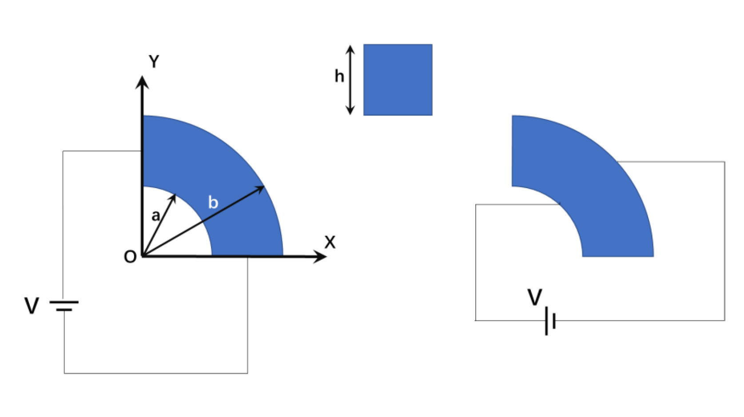
Problem 1
A conducting material of thickness h and uniform conductivity σ has the shape of a quarter of a square tube as shown in the figure below, with inner radius a and outer radius b. Calculate the steady electric currents and the resistances in the two cases.

Slide 4
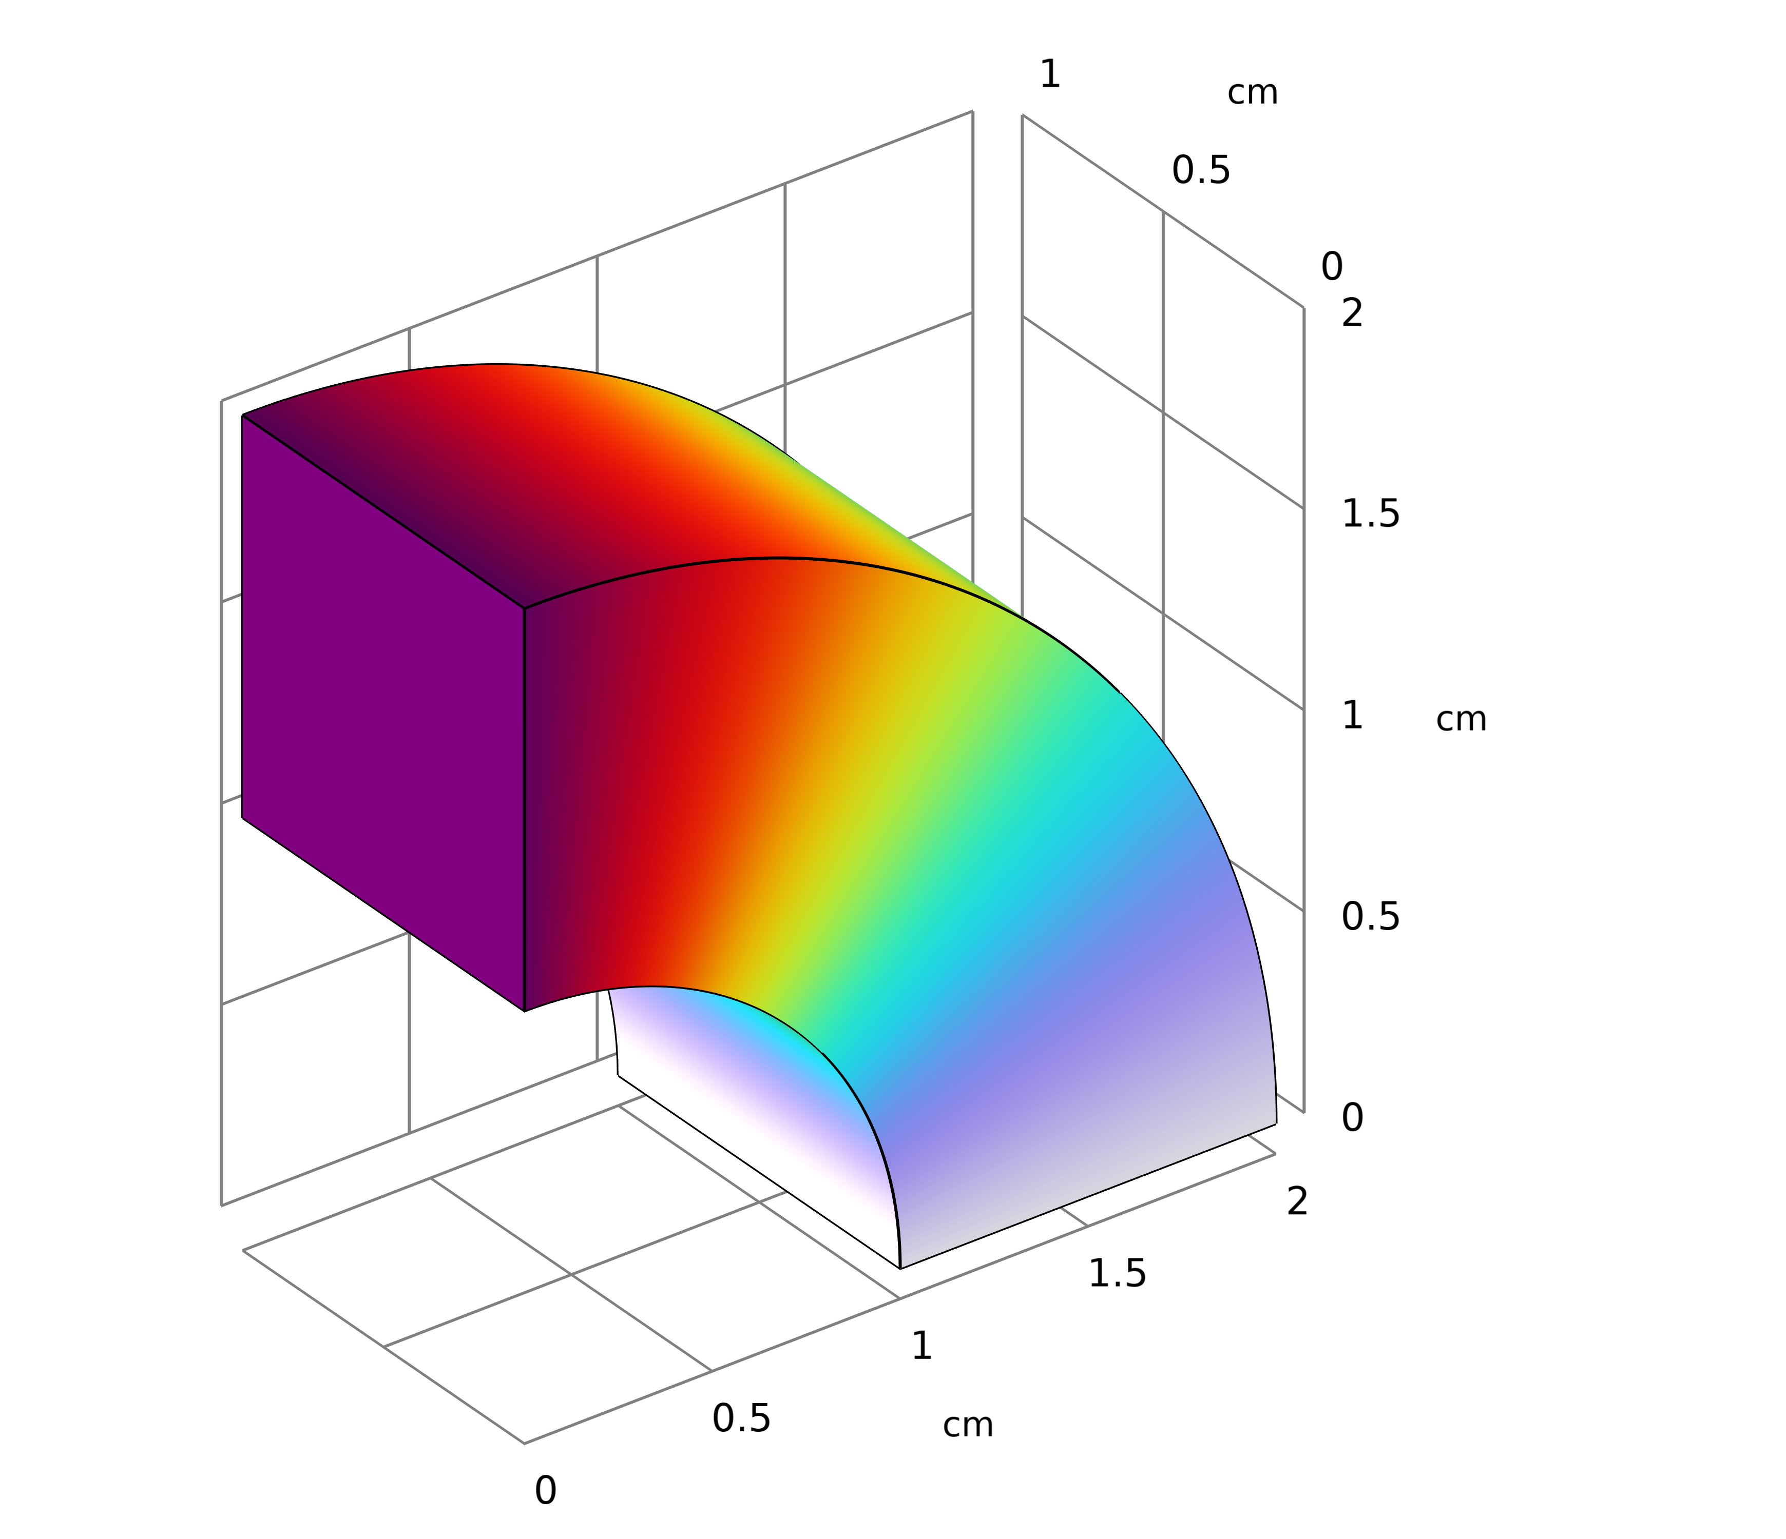
Problem 1
Analytical solution for case 1
Laplace's equation (cylindrical coordinate system)

Slide 5
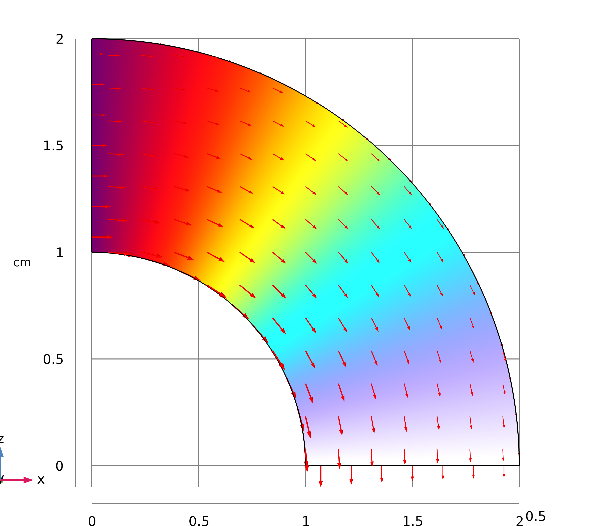

Problem 1
Analytical solution for case 1
The relationship between electric field and electric potential
Ohm’s Law

Slide 6
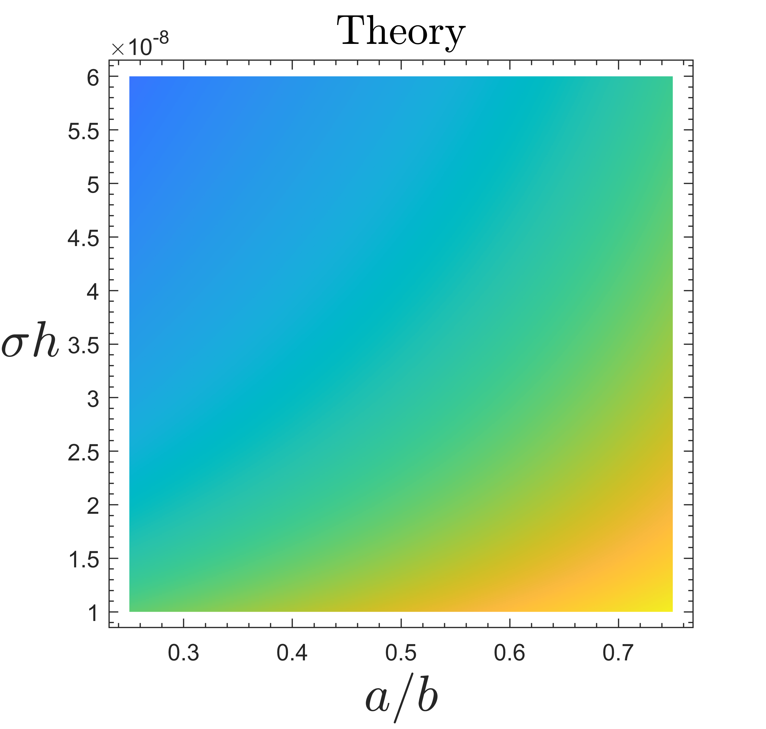

Problem 1
The resistances versus b/a and σh for case 1

Slide 7
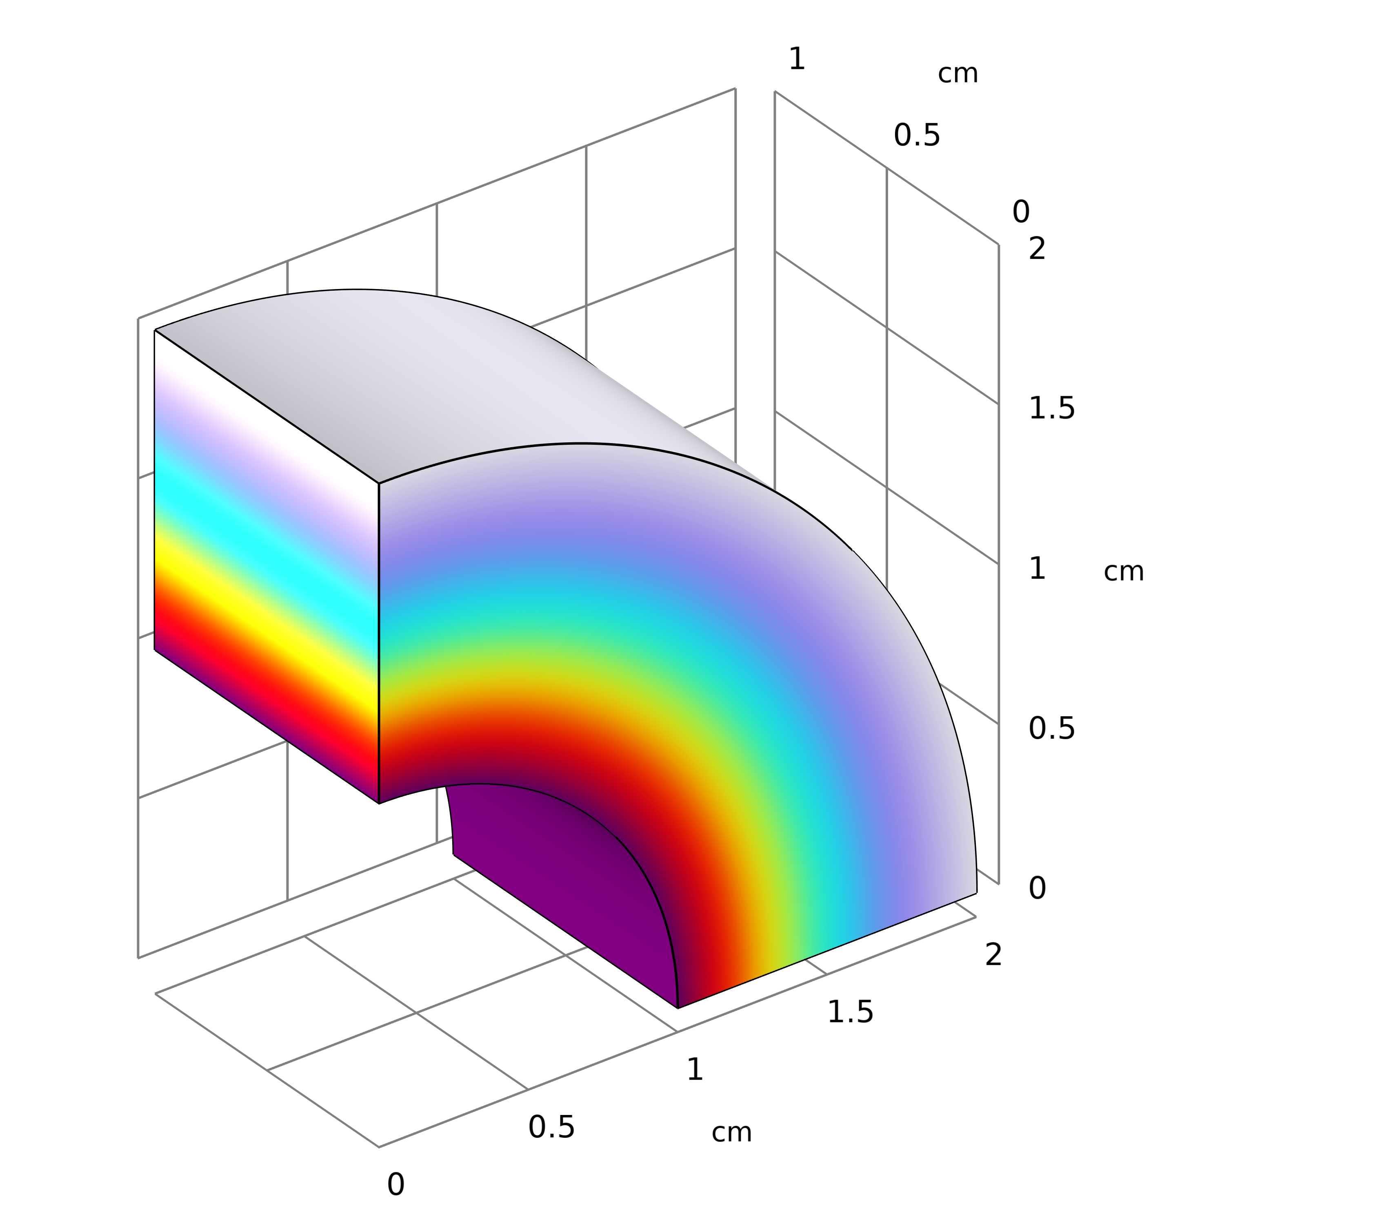
Problem 1
Analytical solution for case 2
Laplace's equation (cylindrical coordinate system)

Slide 8
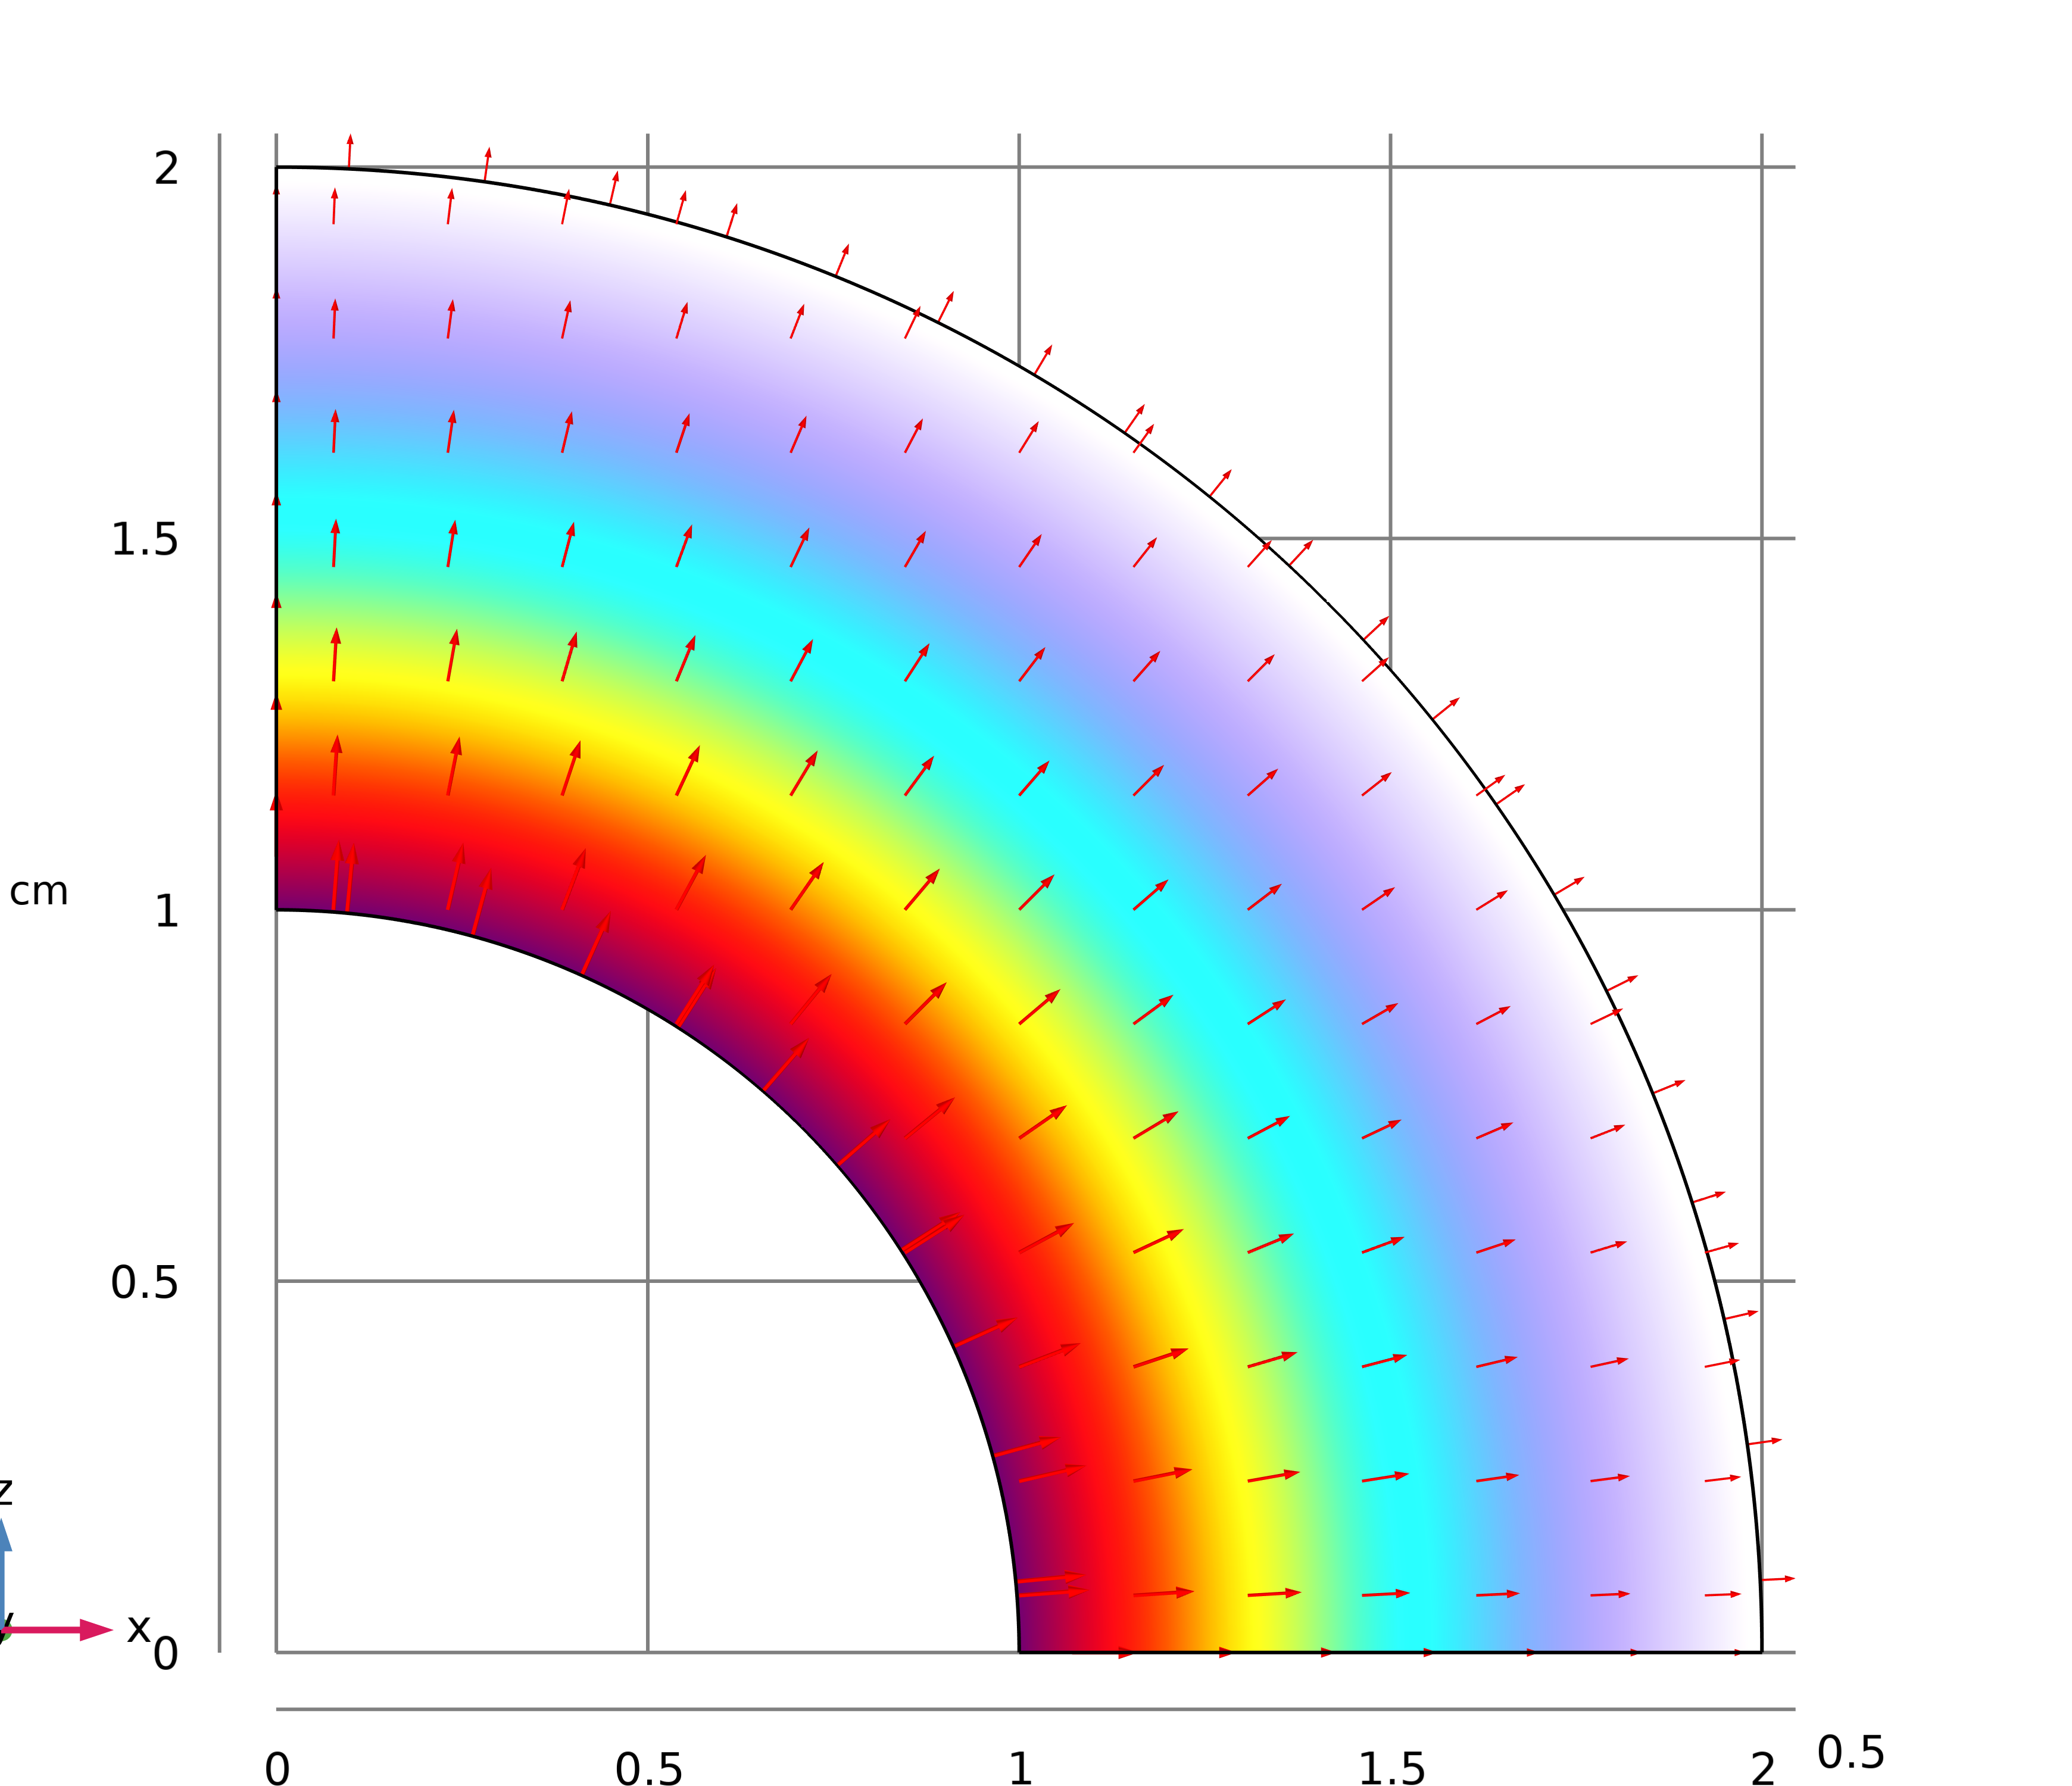
Problem 1
Analytical solution for case 2
The relationship between electric field and electric potential
Ohm’s Law

Slide 9
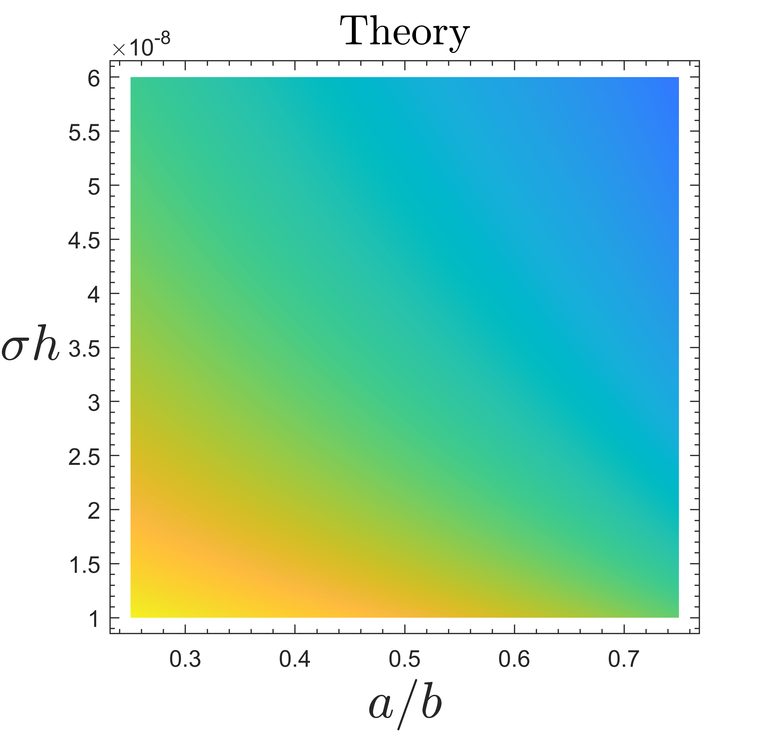
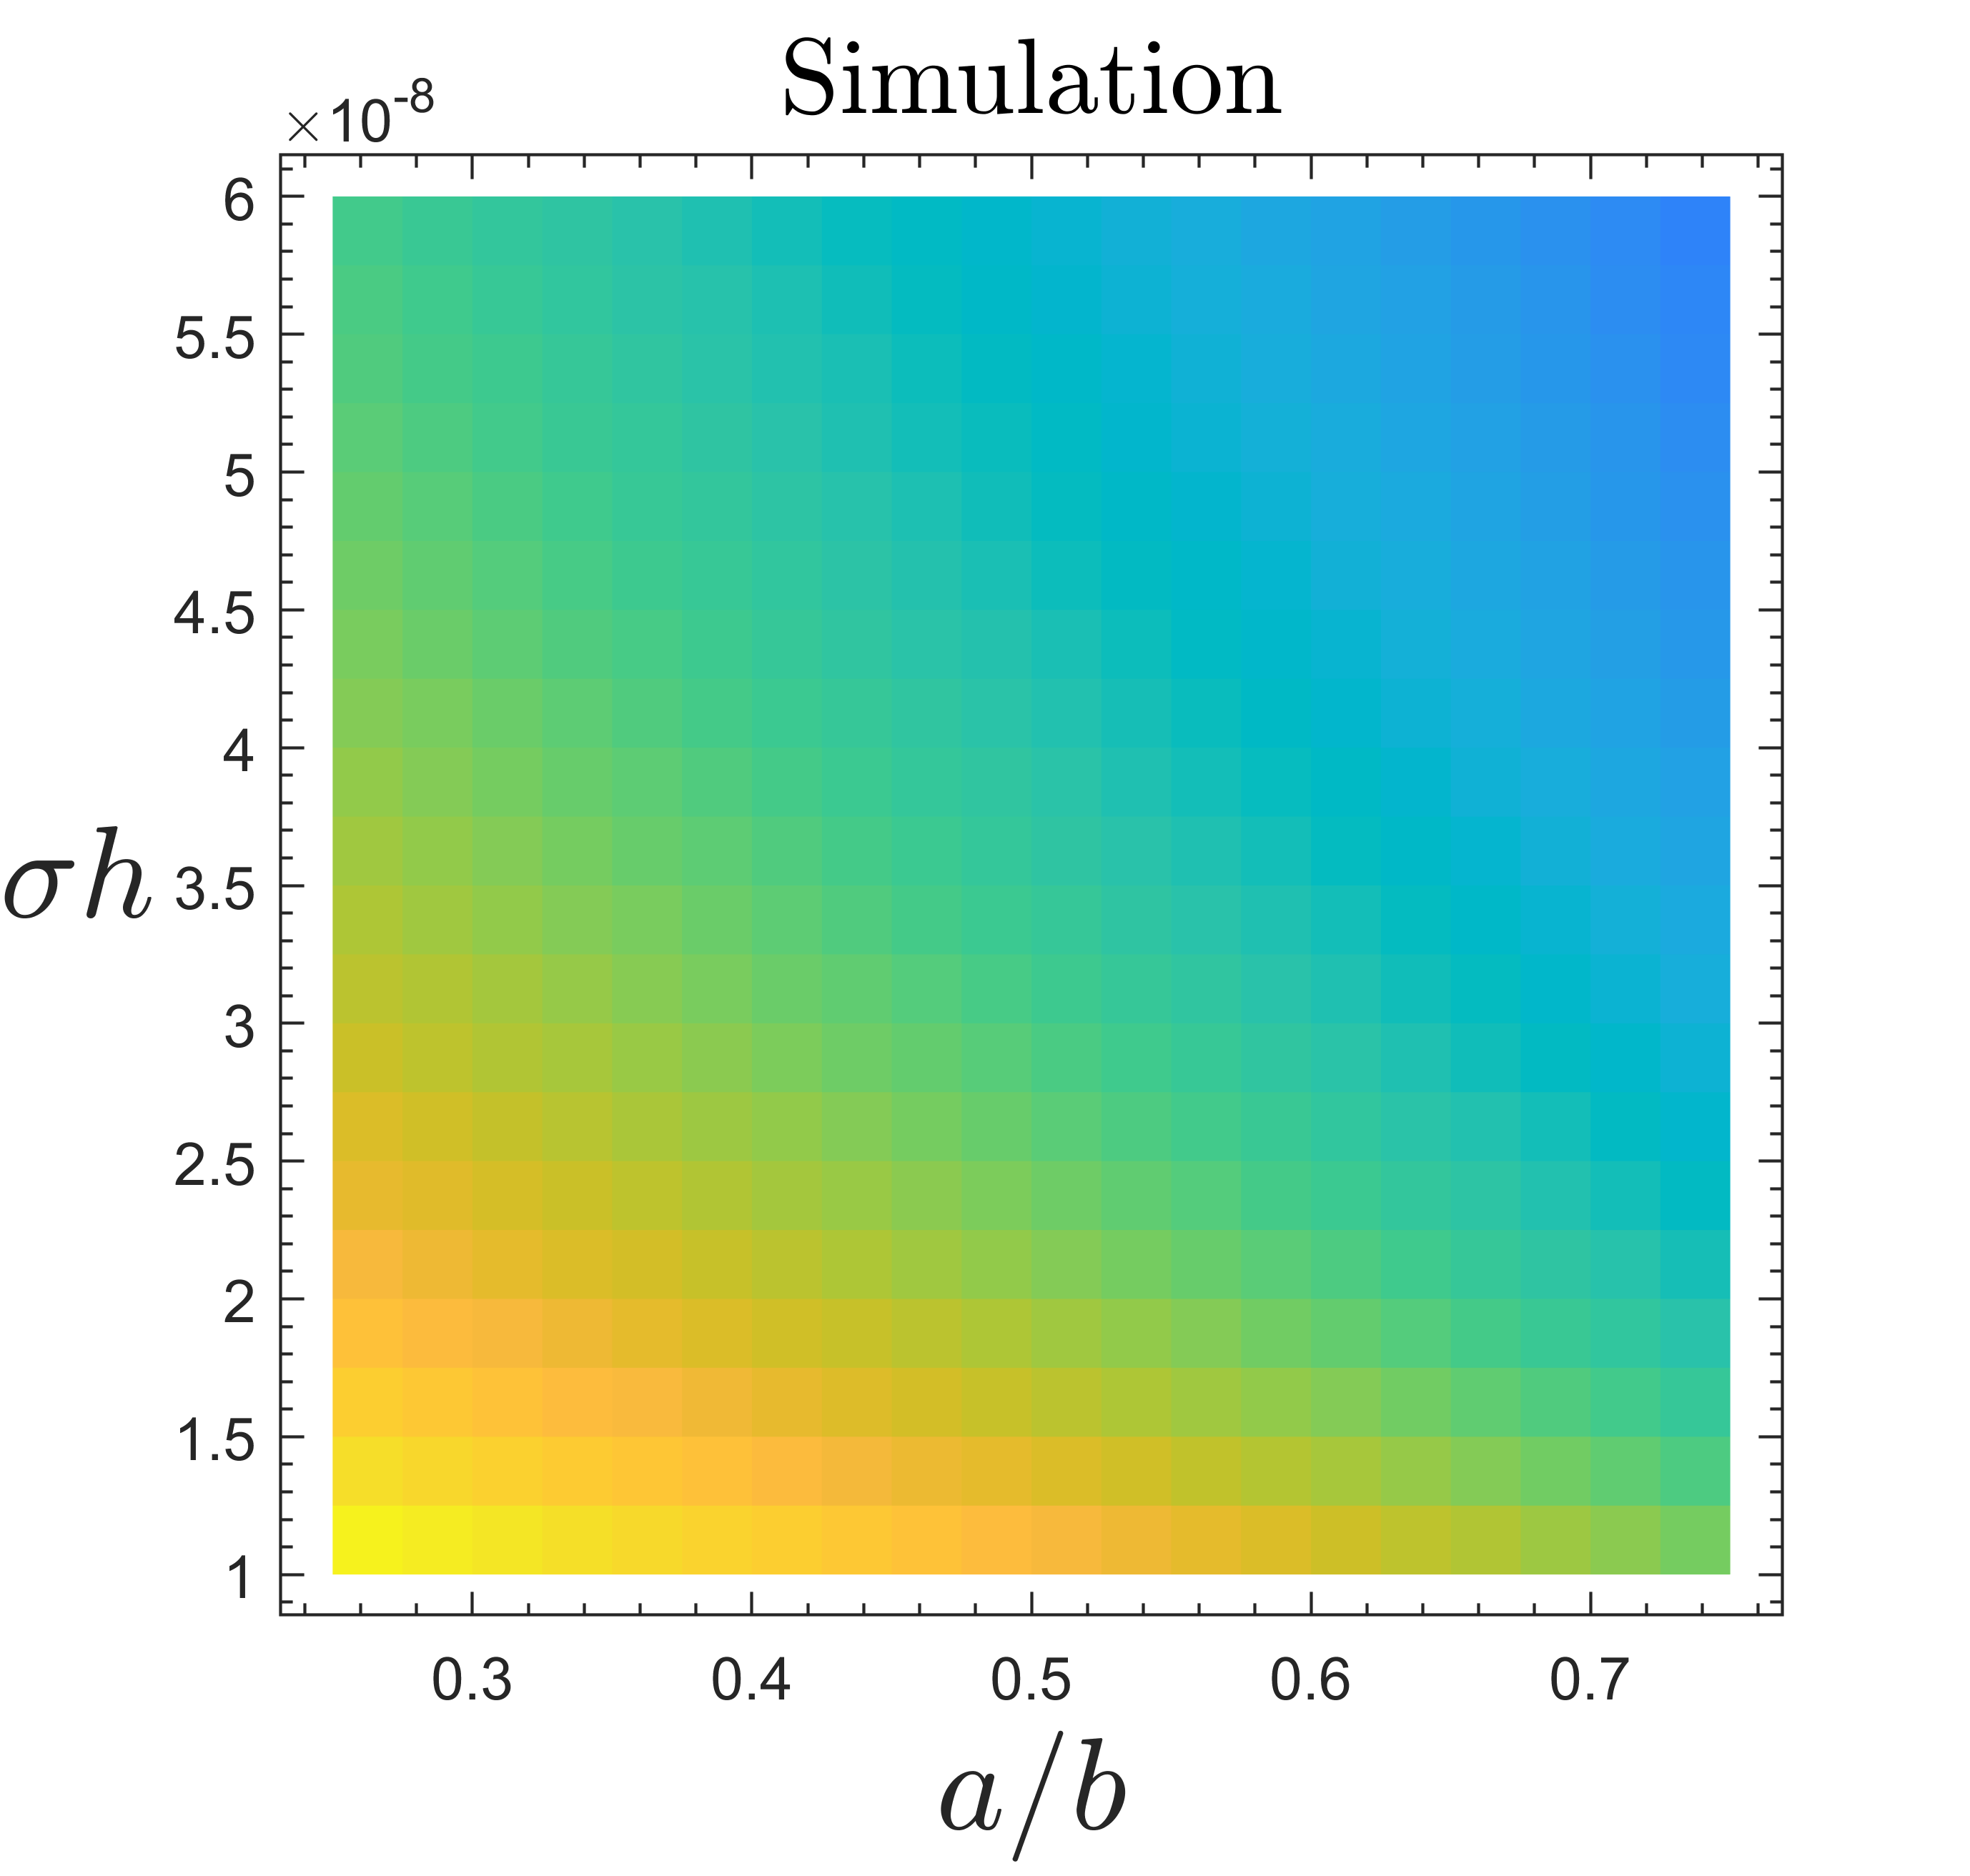
Problem 1
The resistances versus b/a and σh for case 2
Thanks to Shuaiyang Wei !

Slide 10
Problem 2

Slide 11
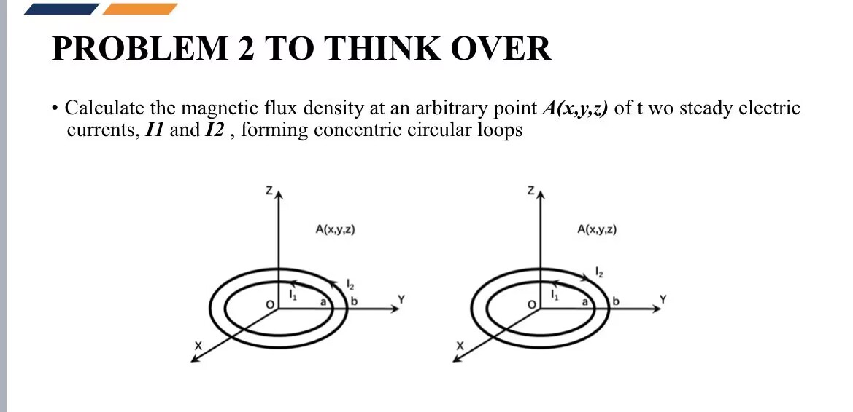
Problem 2
Calculate the magnetic flux density at an arbitrary point A(x, y, z) of two steady electric currents, I₁ and I₂ , forming concentric circular loops

Slide 12
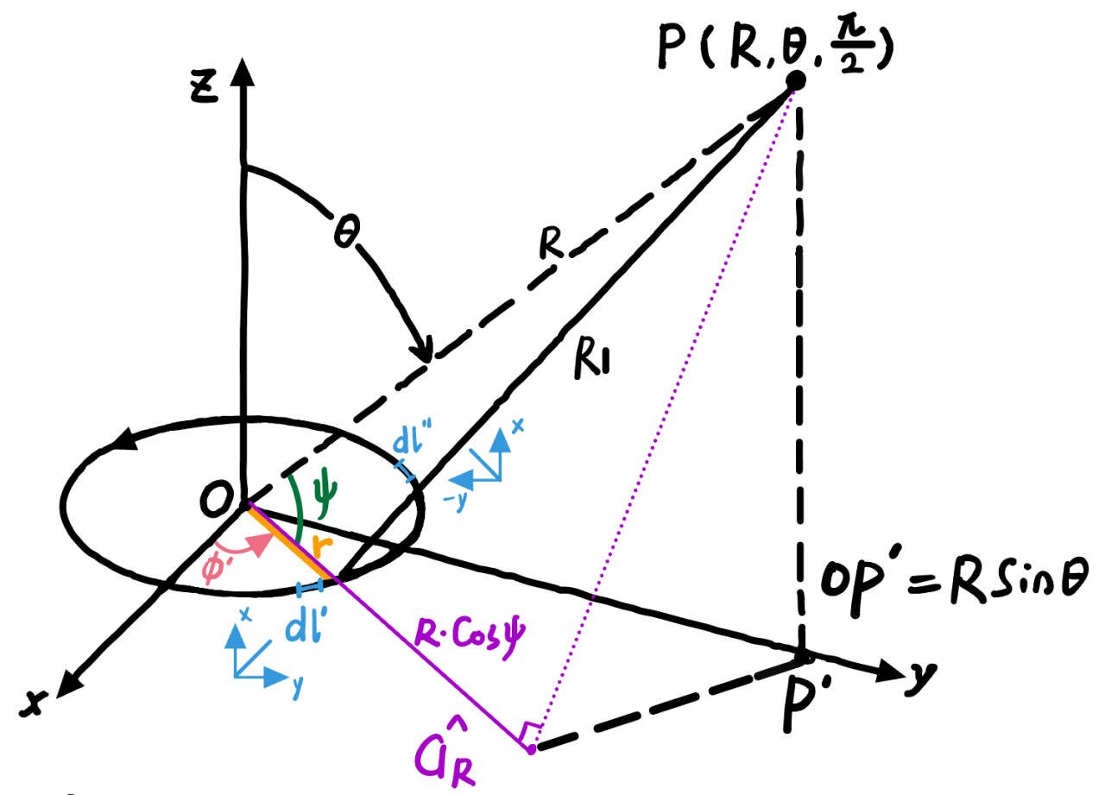

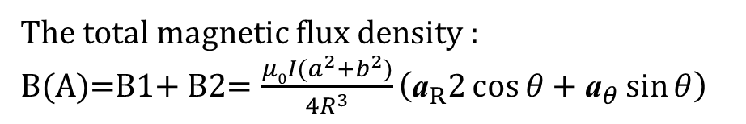
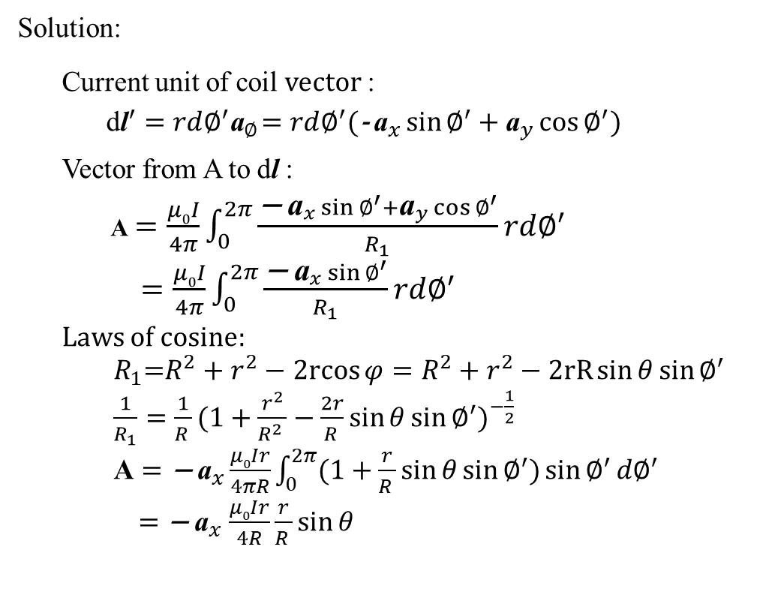
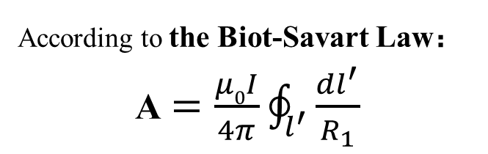
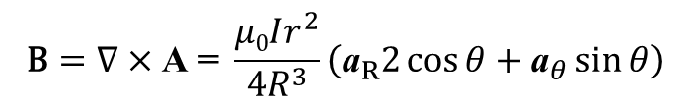
Problem 2
1）Calculate the magnetic flux density when I₁ and I₂ in the same direction
According to the Biot-Savart Law：
A$=\frac{μ0I}{4π}\oint_{l^{′}}^{ }{\frac{{dl}^{′}}{R_{1}}}$
Solution:
Current unit of coil vector :
$\text{d}{\text{l}}^{′}=rd∅^{′}{\text{a}}_{∅}$ $=rd∅^{′}({\text{− }\text{a}}_{x}\sin{∅^{′}}+{\text{a}}_{y}\cos{∅^{′}})$
Vector from A to $\text{d}\text{l}$:
A$=\frac{μ0I}{4π}\int_{0}^{2π}{\frac{{\text{− }\text{a}}_{x}\sin{∅^{′}}+{\text{a}}_{y}\cos{∅^{′}}}{R_{1}}rd∅^{′}}$
$=\frac{μ0I}{4π}\int_{0}^{2π}{\frac{{\text{− }\text{a}}_{x}\sin{∅^{′}}}{R_{1}}rd∅^{′}}$
Laws of cosine:
$R_{1}$=$R^{2}+r^{2}−$ $2rcos{φ}=R^{2}+r^{2}−2rR\sin{θ}\sin{∅^{′}}$
$\frac{1}{R_{1}}={\frac{1}{R_{ }}(1+\frac{r^{2}}{{R^{2}}_{ }}−\frac{2r}{R_{ }}\sin{θ}\sin{∅^{′}})}^{−\frac{1}{2}}$
$\text{A}={\text{− }\text{a}}_{x}\frac{μ0Ir}{4πR}\int_{0}^{2π}{(1+\frac{r}{R_{ }}\sin{θ}\sin{∅^{′}})\sin{∅^{′}}d∅^{′}}$
${=\text{− }\text{a}}_{x}\frac{μ0Ir}{4R}\frac{r}{R_{ }}\sin{θ}$
$$\text{B}=∇×\text{A} \text{=} \frac{μ0Ir^{2}}{4R^{3}}\left({\text{a}}_{R}2\cos{θ}+{\text{a}}_{θ}\sin{θ}\right)$$
OP $′$
The total magnetic flux density :
B(A)=B1+ B2= $\frac{μ0I(a^{2}+b^{2})}{4R^{3}}\left({\text{a}}_{R}2\cos{θ}+{\text{a}}_{θ}\sin{θ}\right)$

Slide 13
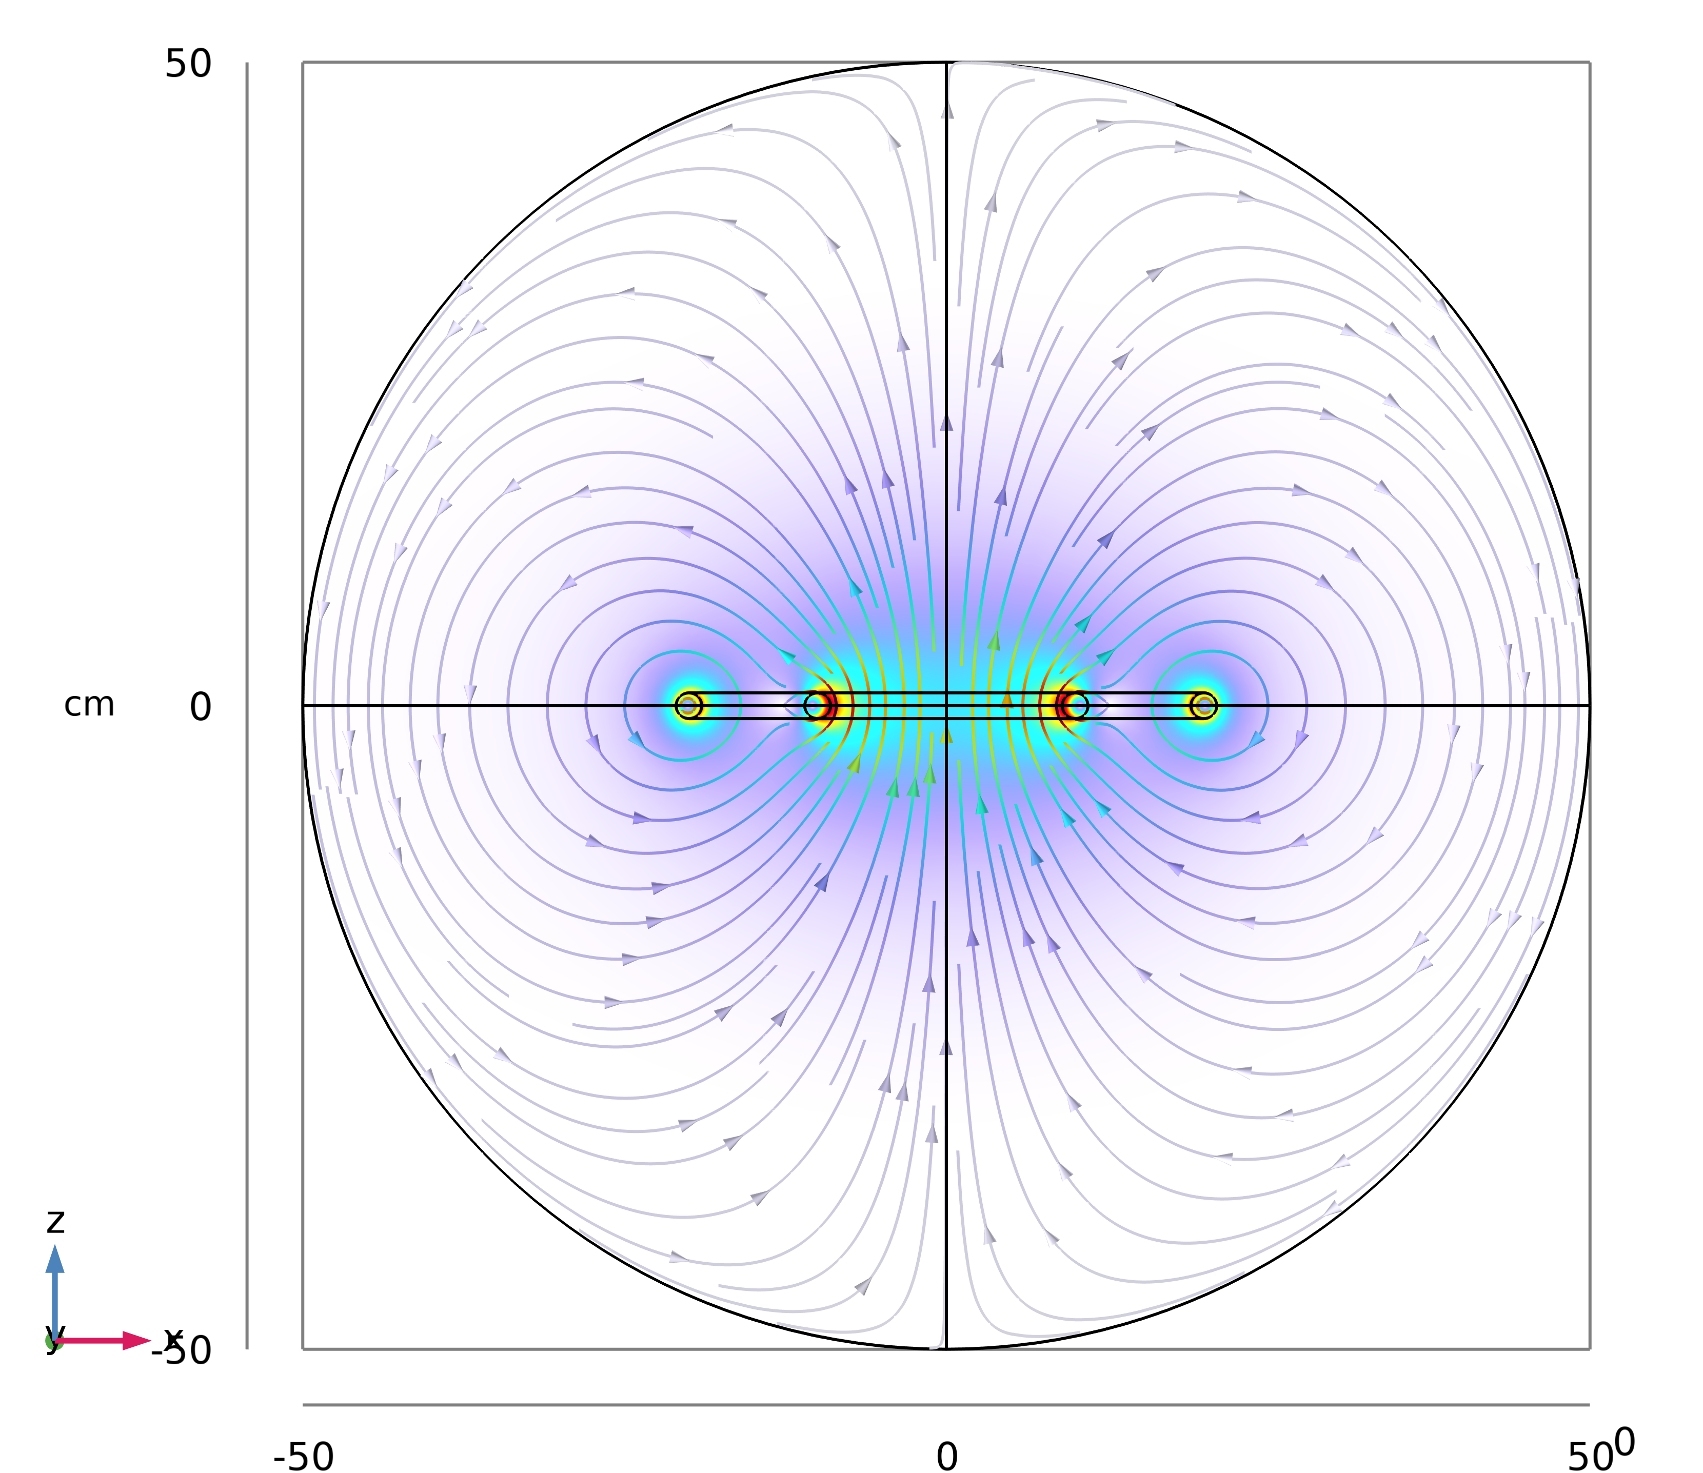
Problem 2
Magnetic field distribution:

Slide 14
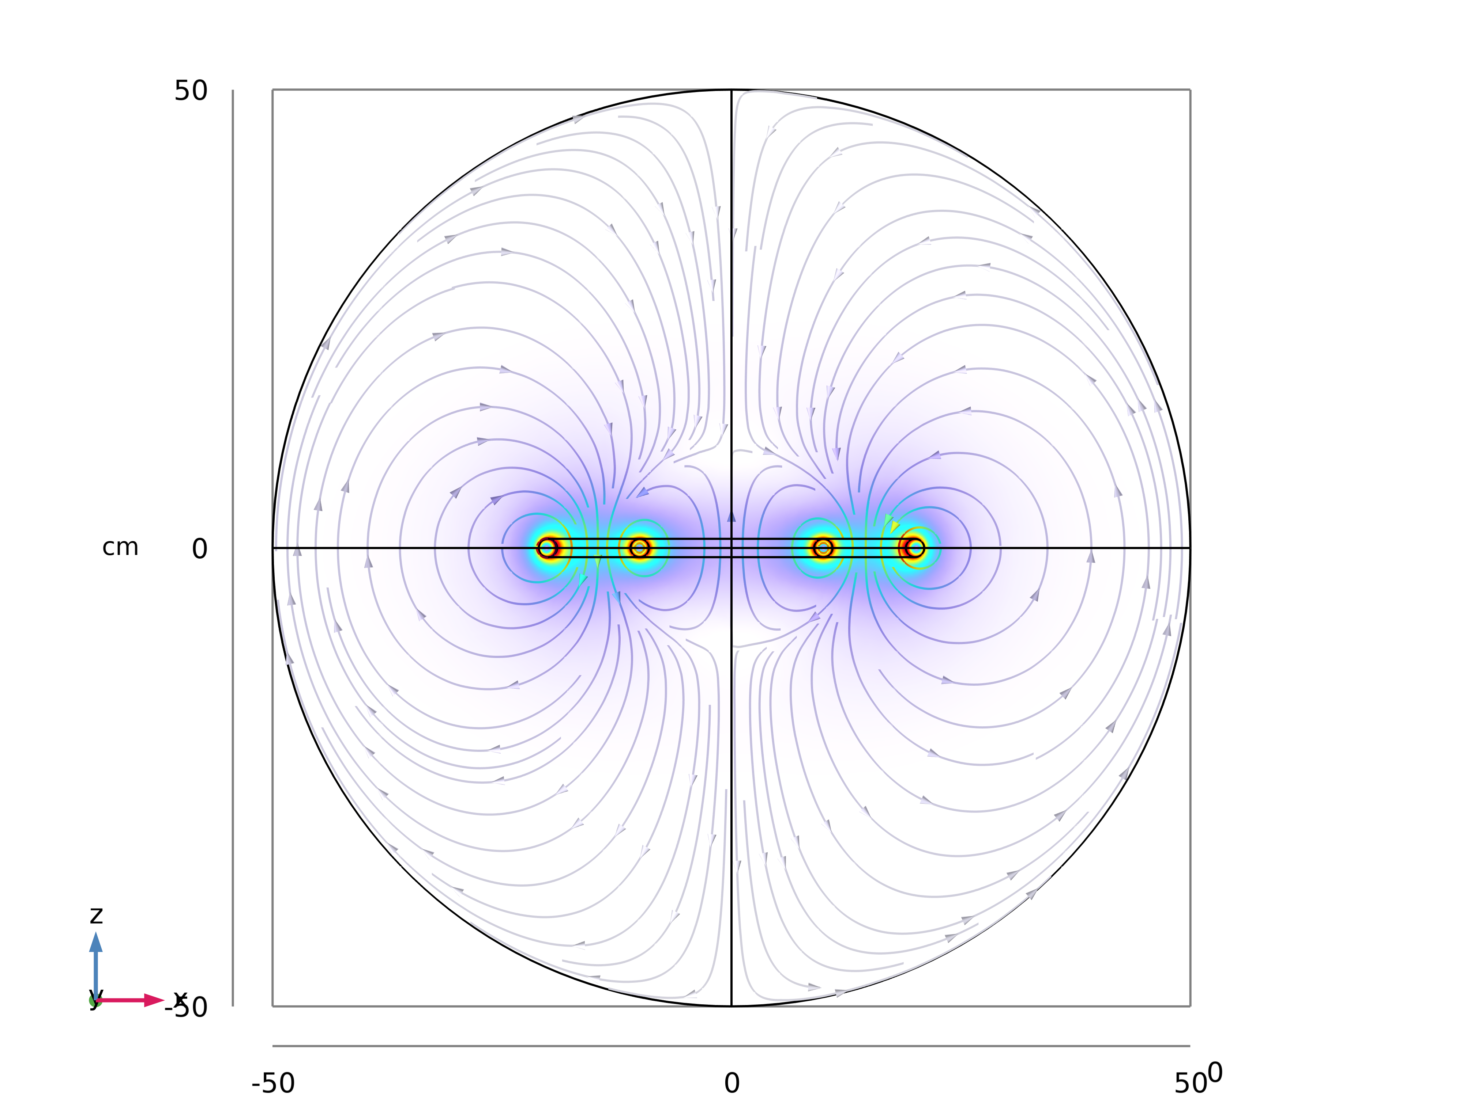
Problem 2
Magnetic field distribution:

Slide 15
THANK YOU
School of engineering
September 27, 2024

